Slide 1

Website Programming
□ DHTML□ DOM again

Slide 2
DHTML dynamic HTML
a collection of technologies to create animated and interactive websites
HTML
CSS
Javascript
DOM
server side applications
the idea is to change content in a static HTML transforming it in a dynamical environment
you can change dropdown boxes based on different selections; you could move elements in the window; use rollover buttons;

Slide 3
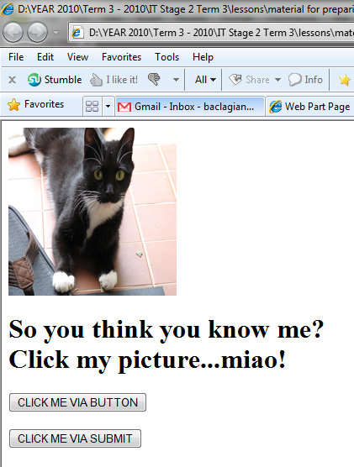
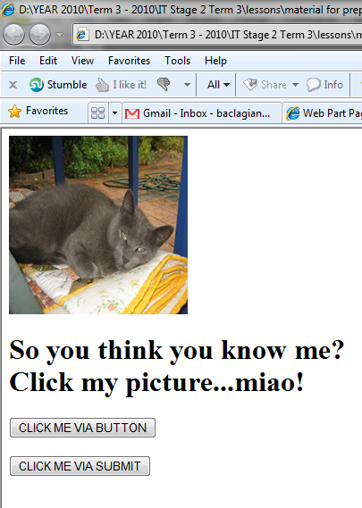
example click on the image to change it
more examples here: yes, here

Slide 4
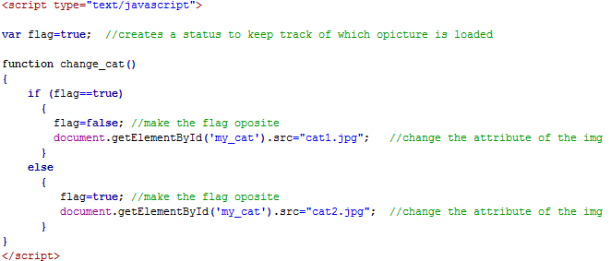

Slide 5


submit versus button
submit is used when we want to sent the entire form to JS the form will be updated, all text boxes or check boxes will be reset
the variables are loosing their values

Slide 6
DOM objects
go here to refresh the Dom objects
all elements in an HTML file will be arranged in arrays based on the type
you can access them using their id or position in these arrays
you can use methods or properties already written for them
for example for the object SELECT (which is a drop down list) you can use remove() or add() to add or remove options in the list

Slide 7
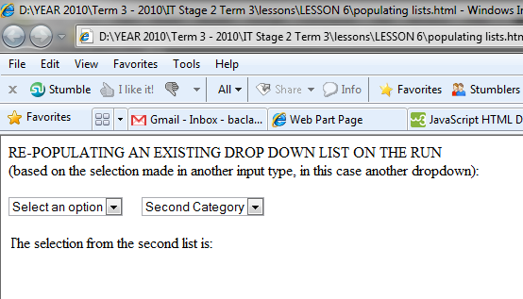
REPOPULATING AN EXISTING LISTS ON THE GO
I want to change the values in the second drop down list when I choose a value in the first

Slide 8
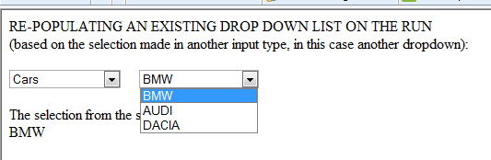
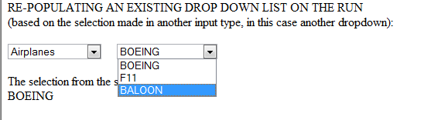
the idea behind is to remove all existing options in the second list and then to add the new ones
you remove them using the DOM method remove() and append the new options using the DOM method add()
you access the element using its name or id

Slide 9
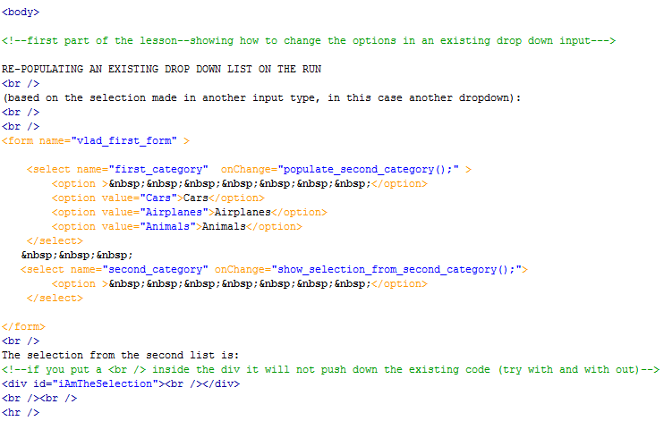
HTML code

Slide 10
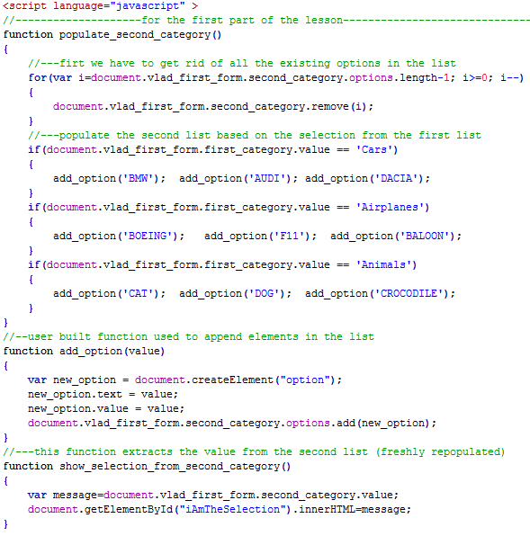
JS code

Slide 11
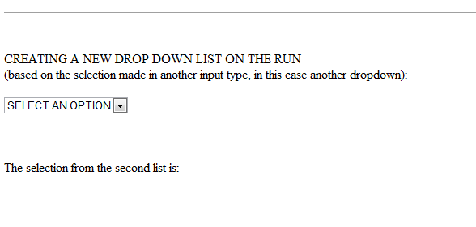
CREATING A NEW LISTS ON THE GO
I want to create a new list with hard coded options

Slide 12
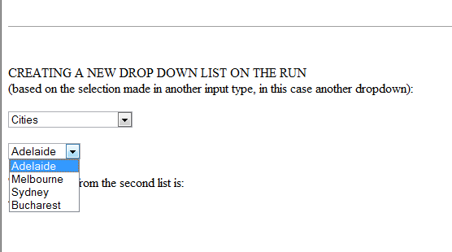
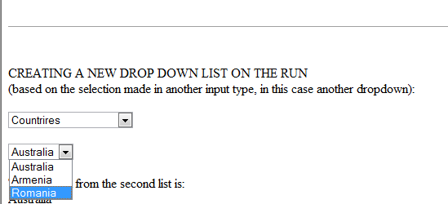
the idea behind is to generate the entire HTML code for the list and then output that element to an invisible element like DIV
you access the invisible element by id or name
it doesn't have to be invisible, you can actually replace and entire existing element

Slide 13
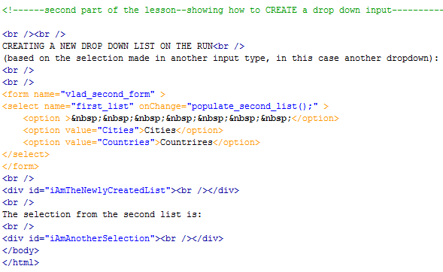
HTML code

Slide 14
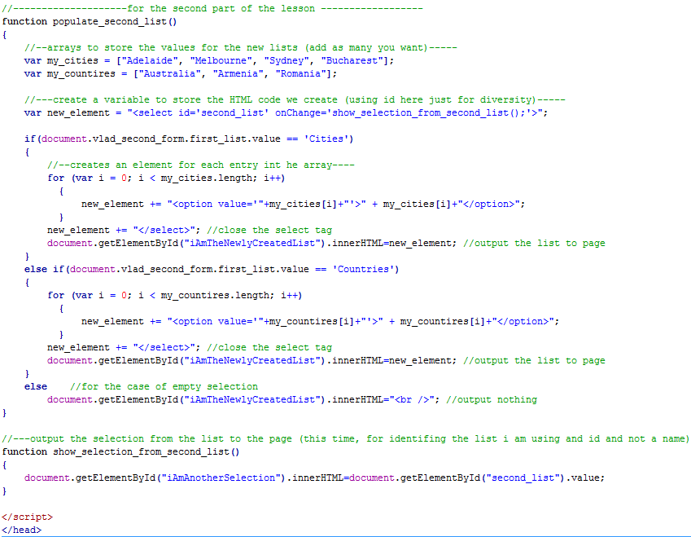
JS code

Slide 15
USER GUIDE Task 6: DHTML
Problem: in your User Guide create an HTML and JavaScript program that does the followings:
you implement one of the above options (repopulate or generate)
you have to use two different forms of input
for example the first input is RADIO and the second one a SELECT
or the first one is TEXT and the second one SELECT

